Slide 1
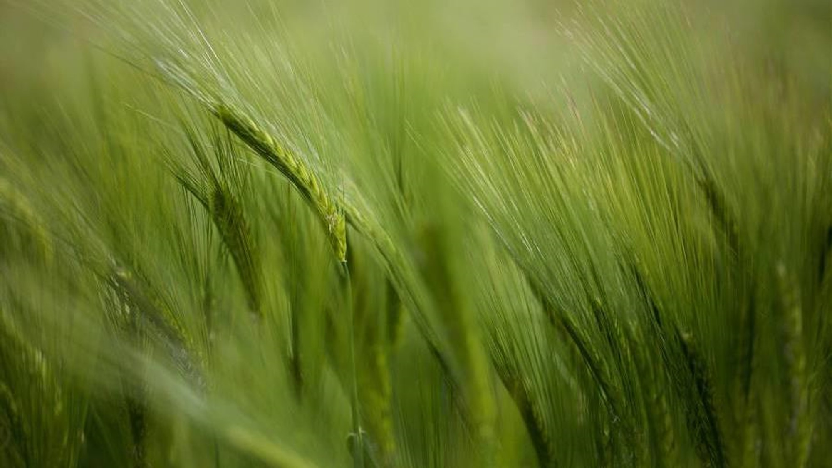
Group 2 – Energy Project
Shasenem, Petter, Belal, Lara

Slide 2
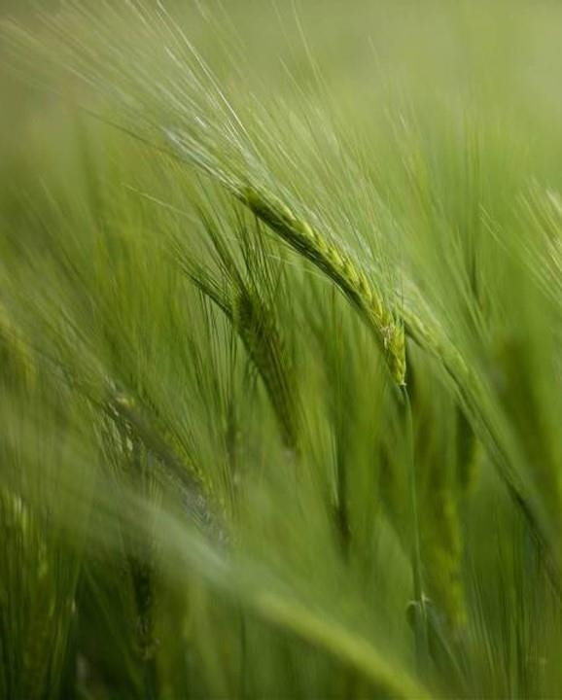


Slide 3
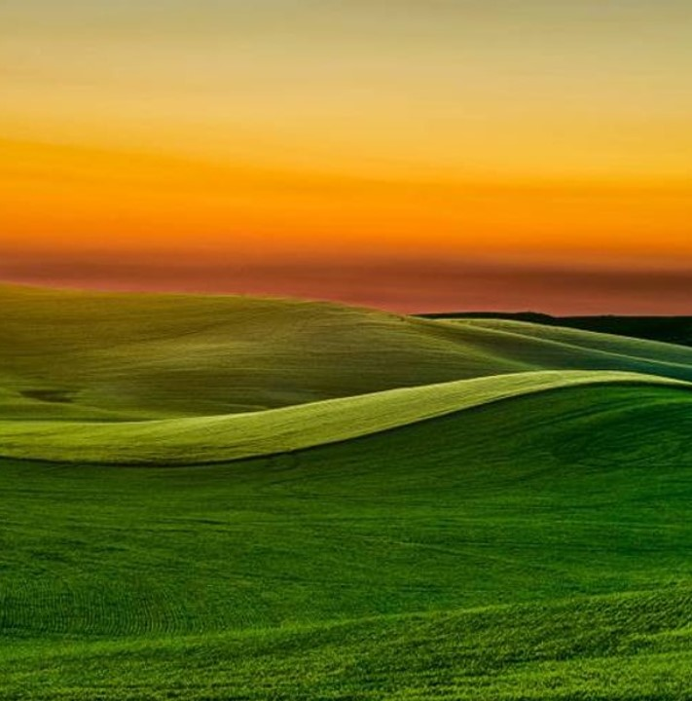
2030?
Will we reach the UN goals by 2030?
Substantially increase the share of renewable energy in the global energy mix.
2) Double the global rate of improvement in energy efficiency.
3) Ensure universal access to affordable, reliable and
modern energy services

Slide 4
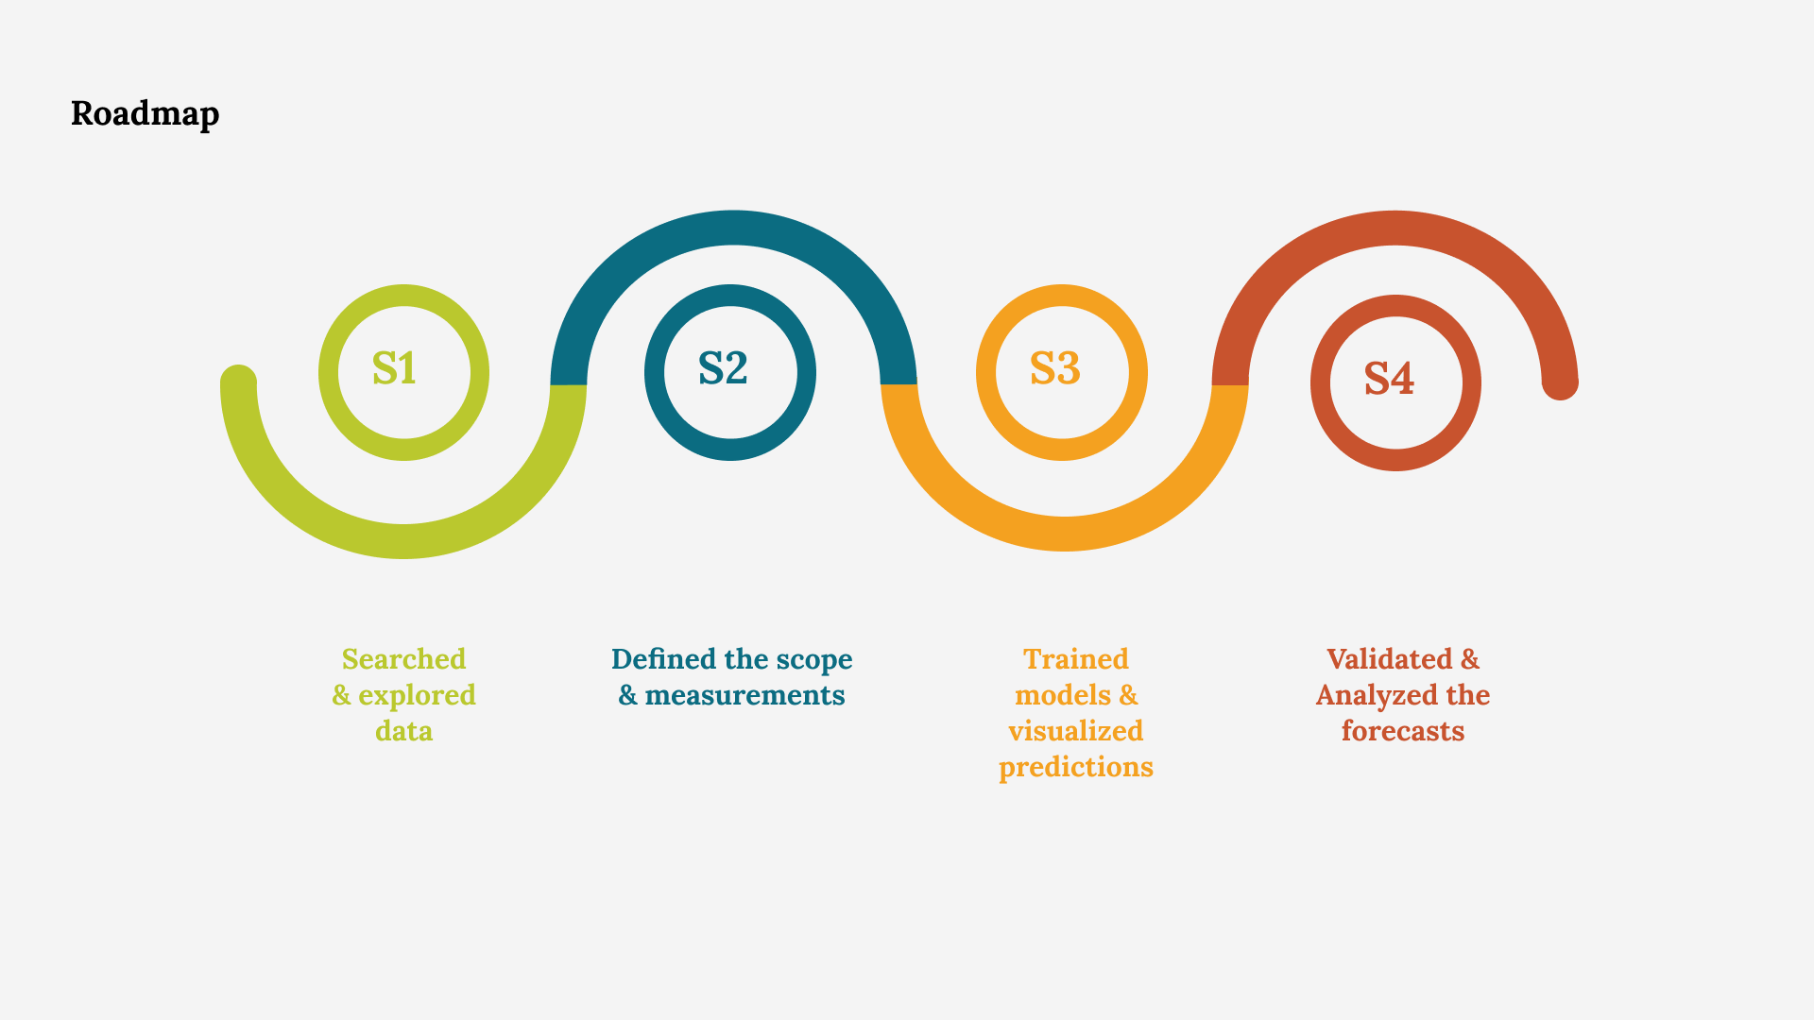

Slide 5
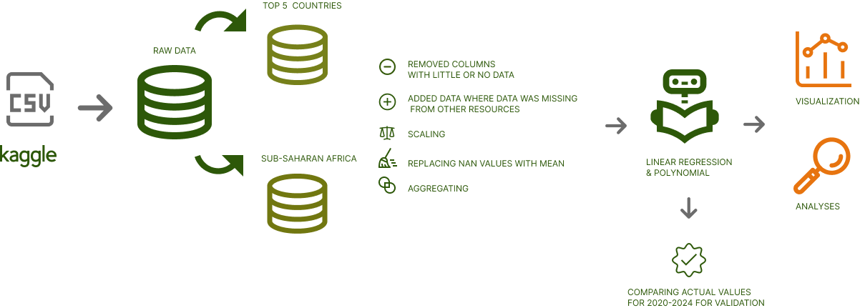
Methods

Slide 6
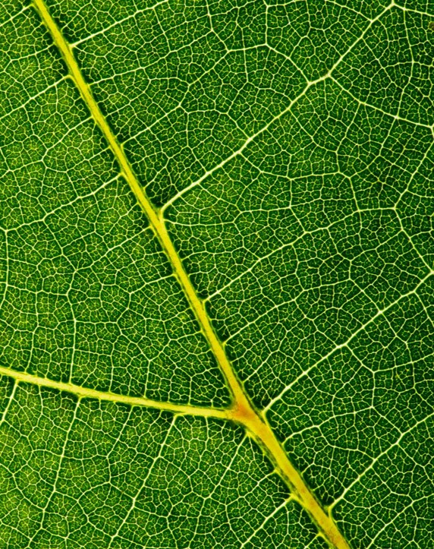
Data
Dataset with detailed information on sustainable energy for the years from 2000 to 2020
Data from Kaggle.
Based on combined source of information from World Bank, International Energy Agency and Our World in Data

Slide 7
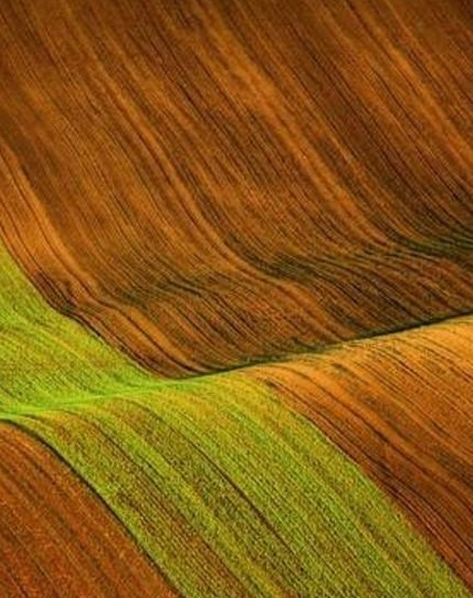
Focus points
Top 5 emitting countries in the world
Countries with lowest access to energy (Sub-Saharan Africa)

Slide 8
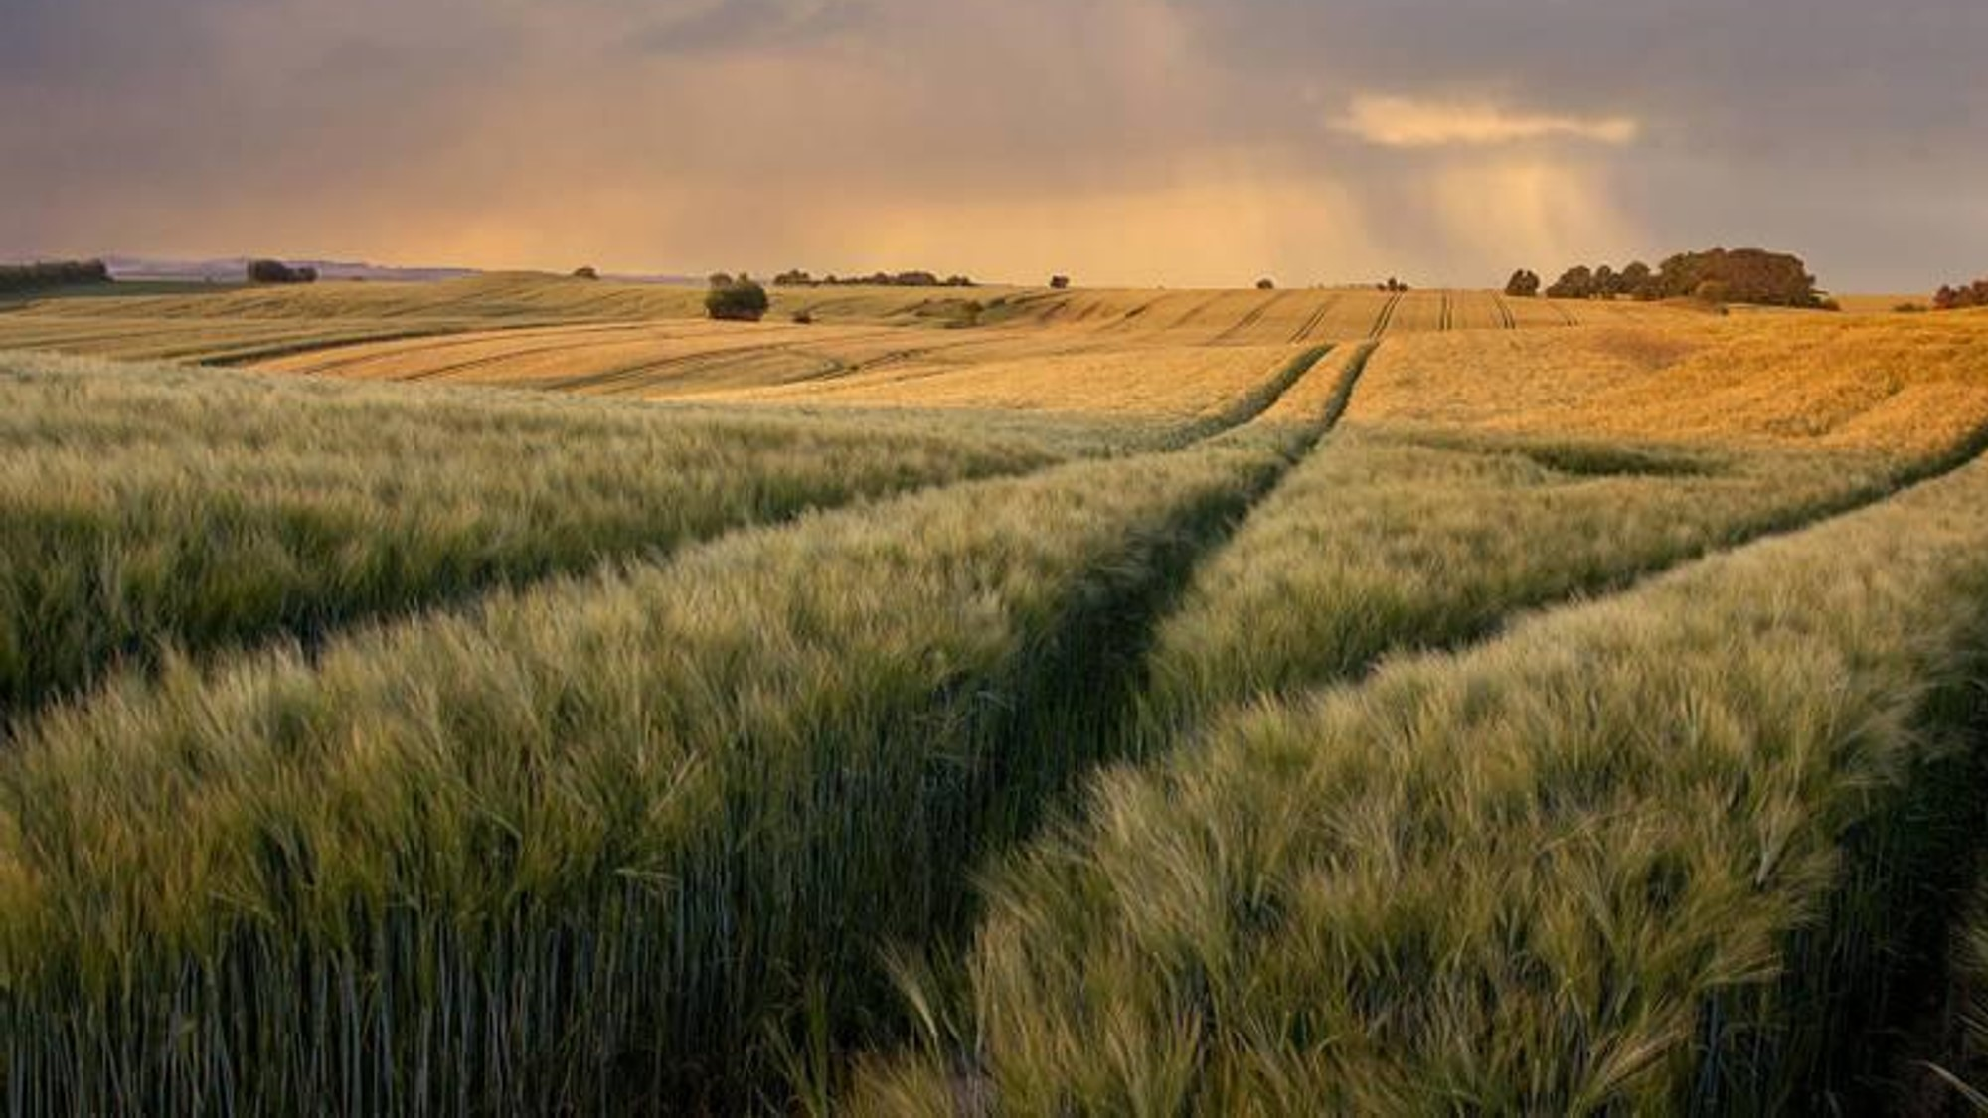
Top 5 emitting countries

Slide 9
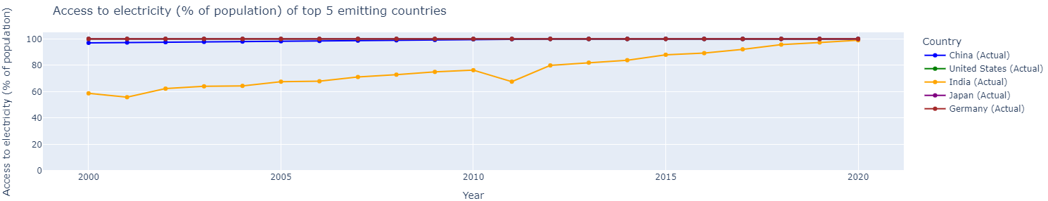
Access to electricity (% of population) of top 5 emitting countries
Goal 7.1

Slide 10
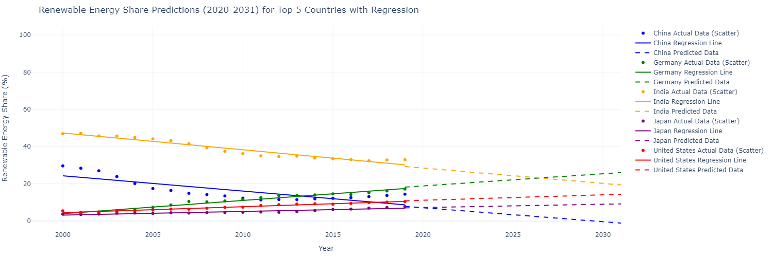
renewable energy share (%) top 5 emitting countries
Goal 7.2

Slide 11
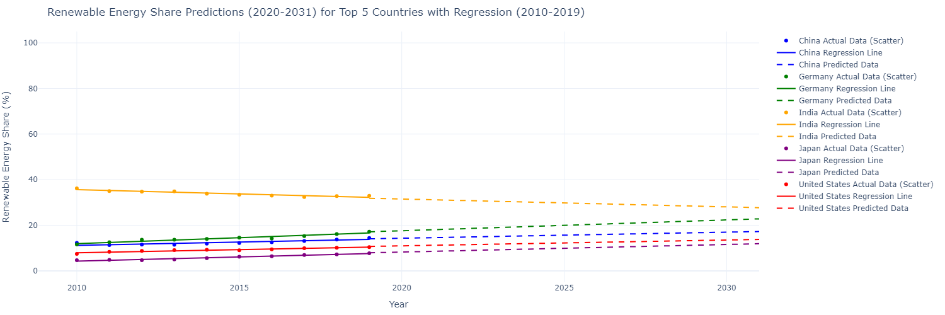
renewable energy share (%) top 5 emitting countries
Goal 7.2

Slide 12
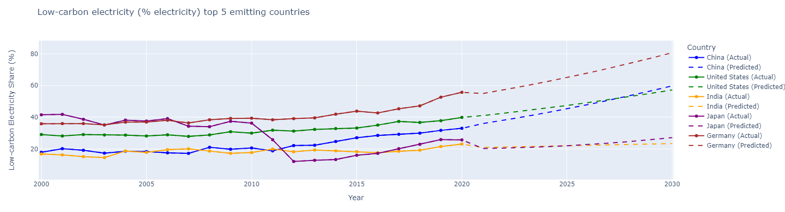
Low-carbon electricity (%) top 5 emitting countries
Goal 7.2

Slide 13
Sub-Saharan africa

Slide 14
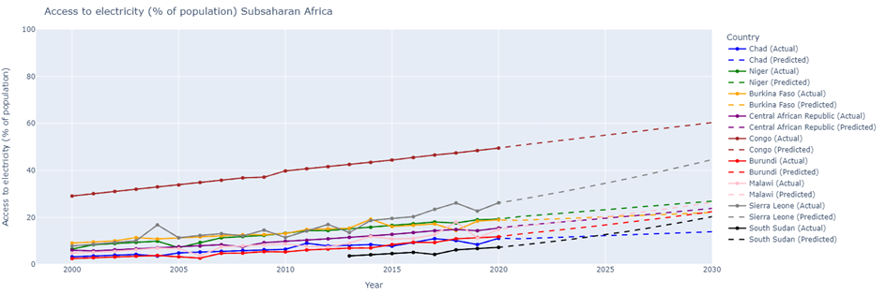
Access to electricity (% of population) IN sub-Saharan countries
Goal 7.1

Slide 15
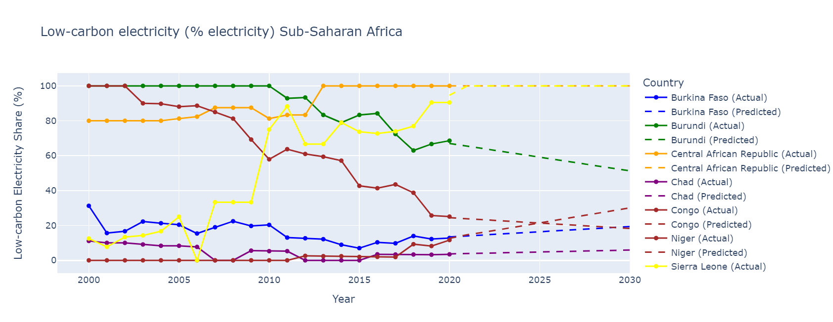
Low carbon electricity share (%) sub-Saharan countries
Goal 7.2

Slide 16
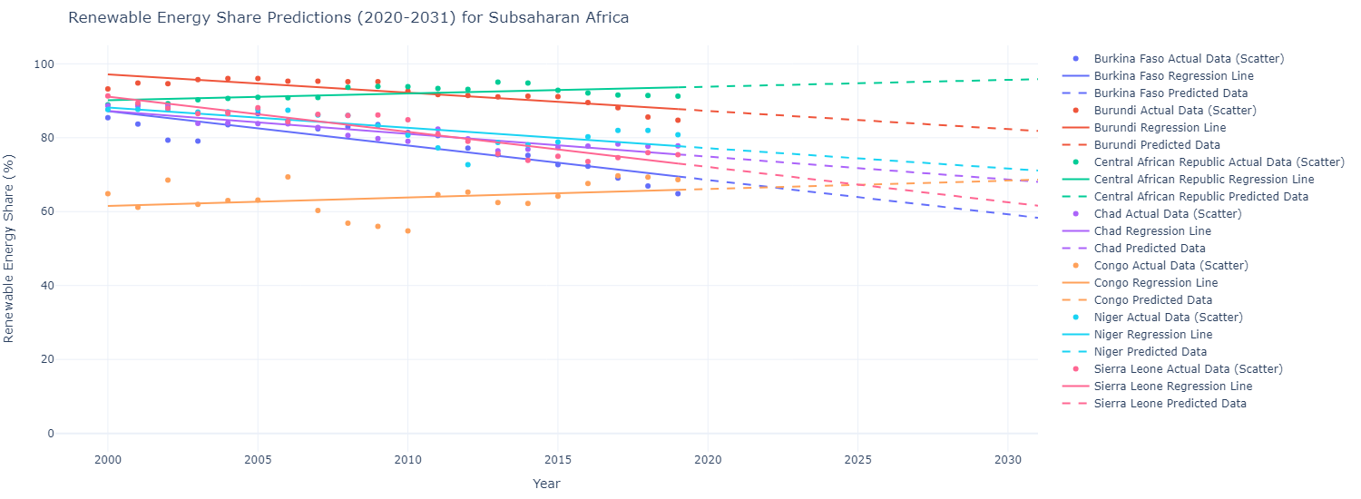
renewable energy share (%) sub-Saharan africa
Goal 7.2

Slide 17
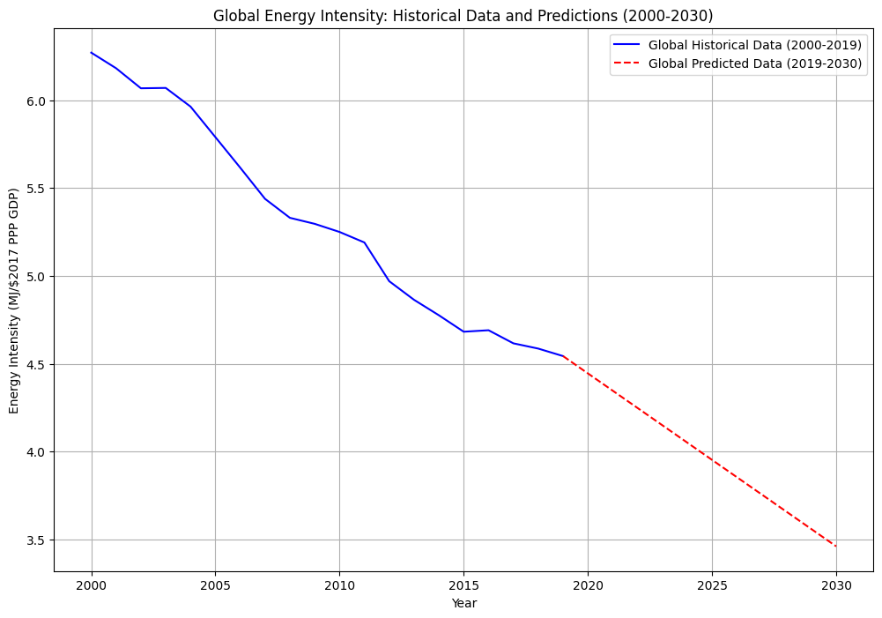
Global energy intensity
Goal 7.3

Slide 18


2030?
Will we reach the UN goals by 2030?
Increase substantially the share of renewable energy in the global energy mix.
2) Double the global rate of improvement in energy efficiency.
3) Ensure universal access to affordable, reliable and
modern energy services

Slide 19
Going forward
Analyse the data further
Dig deeper into other regions/clusters
Find the underlying causes behind environmental phenomenona
Incorporate other reliable sources of data
Research possible future funding, “follow the money”
Update predictions when new data is published
Compare different models to find the best working solution to each problem

Slide 20
Q & A

Slide 21
Thank You!
Shasenem, Petter, Belal, Lara

